Slide 1
Crash Course: Introduction to Processing

Slide 2
In this Crash Course
What is programming/coding?
What is Processing?
Pre-defined functions
setup()
draw()
rect()
line()
ellipse()
random()
fill()
print() and println()
Summary

Slide 3
What is Programming?
Programming is a creative process which provides instructions for a computer. However computers don’t understand the meaning of words like humans do - so how do we write something that a computer will be able to understand?
Programming languages allow us to use high level commands that make sense to us, and with the use of a compiler convert these into low level commands (often a series of zeros and ones) that the computer can interpret
There are multiple programming languages, such as Python, C#, C++, Java, and many more which all have their advantages and disadvantages. Processing is one of these programming languages.

Slide 4
What is Programming?
Due to the highly technological world we live in, programming is essentially in every aspect of our lives. From the phones we use, to the cars we drive - they all rely on some sort of programming
Coding is the basis of fields such as software engineering and computer science, but can be found and applied in virtually all industries, especially in electronics, automation, app development, business, e-commerce, web design or even medicine
It’s an extremely desirable and sought-after skill for employment and post-secondary education in today’s increasingly technology dependent society

Slide 5
What is Processing?
Processing is a user-friendly, open source Java-based program which is somewhat of a sketchbook, enabling you to code in a very visual way
You can start your own programming adventure by downloading the Processing IDE (Integrated Development Environment)
Link to download Processing: https://processing.org/download/
Detailed reference for Processing: https://processing.org/reference/
Note that most lines of code must end with a semicolon (;) to be compiled properly

Slide 6
Predefined Functions
A function is a small, modular, unit of code that can be “called” to complete a defined task
Functions can be used repetitively
They can be user-defined (created by you) or predefined (created by the makers of Processing)
Predefined functions are free for you to use and are stored in a library included in your download of Processing
For now, we will focus only on predefined functions

Slide 7
Predefined Functions
The names of predefined functions are key words recognized by the compiler
Some examples of predefined (or library) functions are setup(), draw(), rect(), size(), ellipse(), random(), print(), println(), fill(), stroke(), and line()
Most functions require inputs or parameters to be put between the brackets to specify details that influence the function’s output
The size() function sets up the size of your sketching/display window and requires two parameters: the width and the height
Typing in the IDE size(500,500); opens a 500 x 500 pixel window (go try it!)

Slide 8
Predefined Functions - setup()
The setup() function is often one of the first functions that you will see when using Processing
setup() is run only once, when the program starts. It’s used to define things such as the screen size and font, which are not changed as the program
It’s important to remember that variables defined in setup() are not accessible by other functions
For every program, there can only be one setup() function, and it should not be used more than once per program

Slide 9
Predefined Functions - draw()
Another function seen commonly throughout Processing is the draw() function, which is often directly below setup()
Unlike setup(), draw() will continously run through its code in a loop, until stopped. draw() is essentially what will update the window you have created based on the program that you wrote
Like setup(), each program can only have one draw() function, and the draw() function will always run automatically right after setup()
We can control the number of times draw executes each second by using the frameRate() function, and setting the frame rate to the desired value

Slide 10
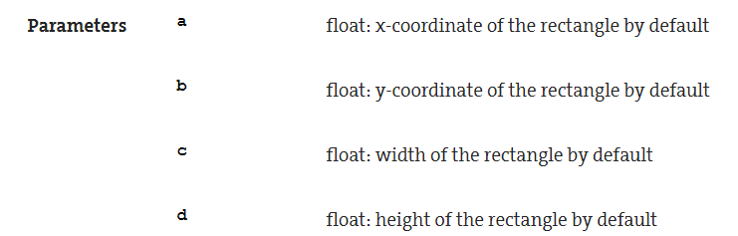
Predefined Functions – rect()
A function like rect() will require four parameters or inputs to draw a rectangle: an x-coordinate, a y-coordinate, width and height
Syntax: rect(a, b, c, d);
For instance, rect(100, 100, 50, 50);, when compiled, draws a square with width and height equal to 50 units, positioned at (100, 100) on the sketching window
Note: syntax is just a fancy word for “grammar”, the correct way to write code so that the compiler (what translates your code into 0s and 1s) can understand it

Slide 11
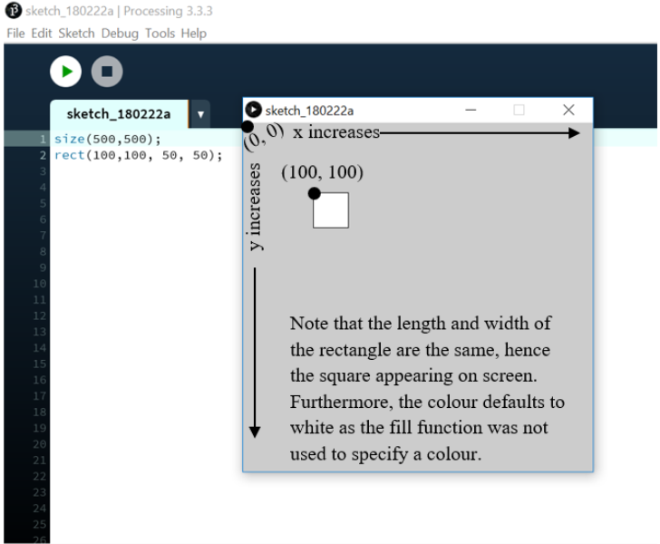
Predefined Functions – rect()
Note that on the Processing sketching window, x values increase from left to right but unlike a normal Cartesian graph, y -values increase from top to bottom

Slide 12
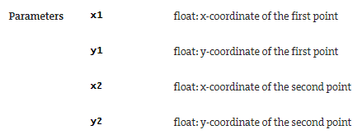
Predefined Functions – line()
The line() function also requires four parameters: the x and y positions of an initial point as well as the x and y positions of a terminal point
Syntax: line(x1, y1, x2, y2);

Slide 13
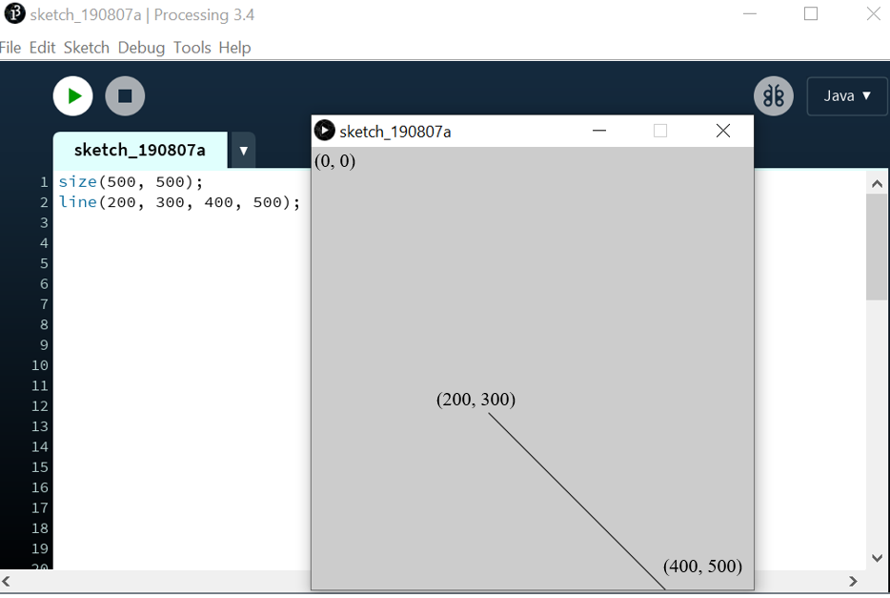
Predefined Functions – line()
For example, line(200, 300, 400, 500); generates a line connecting the points (200, 300) and (400, 500)

Slide 14
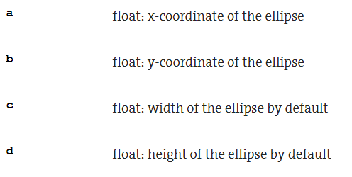
Predefined Functions – ellipse()
The ellipse() function in Processing usually requires four parameters: the x and y coordinates of its centre, as well as its width and height
If the width and height are equal, you have a circle
Syntax: ellipse(a, b, c, d);

Slide 15
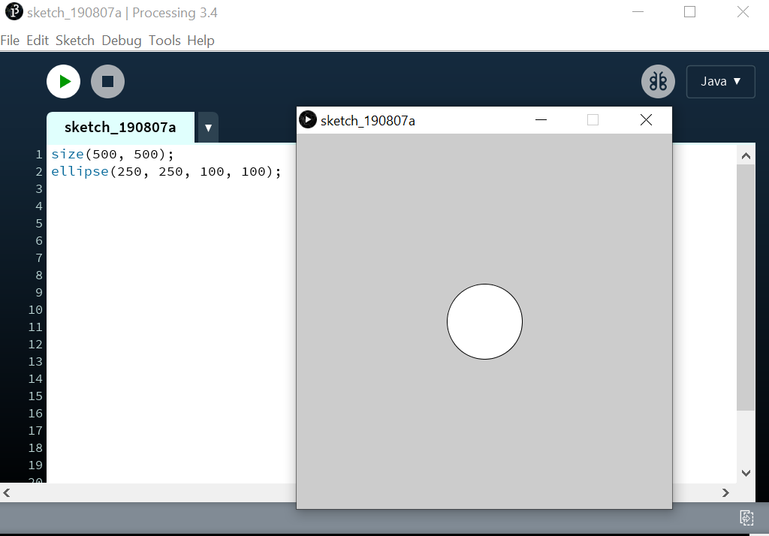
Predefined Functions – ellipse()
For example, ellipse(250, 250, 100, 100); creates a circle at (250, 250) with a height and width of 100 units (a diameter of 100 pixels)

Slide 16
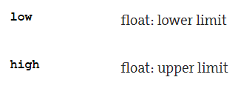
Predefined Functions – random()
random() outputs a random number
For instance, random(15) will return a random number from 0 up to but not including 15
random(5.7, 15) will return a random number from 5.7 up to but not including 15
Random is an example of a function that has optional parameters - not all parameters have to be filled in, as they have some default value
Syntax: random(high); or random(low, high);

Slide 17
Predefined Functions – fill()
The fill() function allows you to colour shapes according to the RGB (Red, Green, Blue) colour scale with values from 0 to 255
The fill() function takes three parameters
fill(0, 0, 0); fills with black
fill(255, 255, 255); fills with white
Any other colour is generated by having various numbers in the first position (amount of red), in the second position (amount of green) and in the third position (amount of blue)

Slide 18
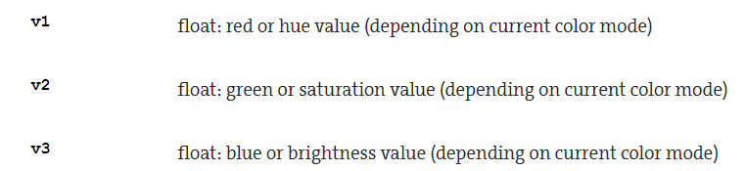
Predefined Functions – fill()
Syntax: fill(v1, v2, v3);

Slide 19
Predefined Functions – fill()
For example, when you write fill(255, 0, 0);, you have turned on all the red light R but have 0 for the amounts of green and blue light G and B (hence you see red)
Note that the colour black may be achieved with a single parameter fill(0), because it assumes the other parameters to be the same and similarly the colour white may be obtained with fill(255)
As you might suspect, any value in between 0 and 255 would generate some other colour on the grayscale
stroke() works exactly like fill() but is used to colour lines instead of shapes

Slide 20
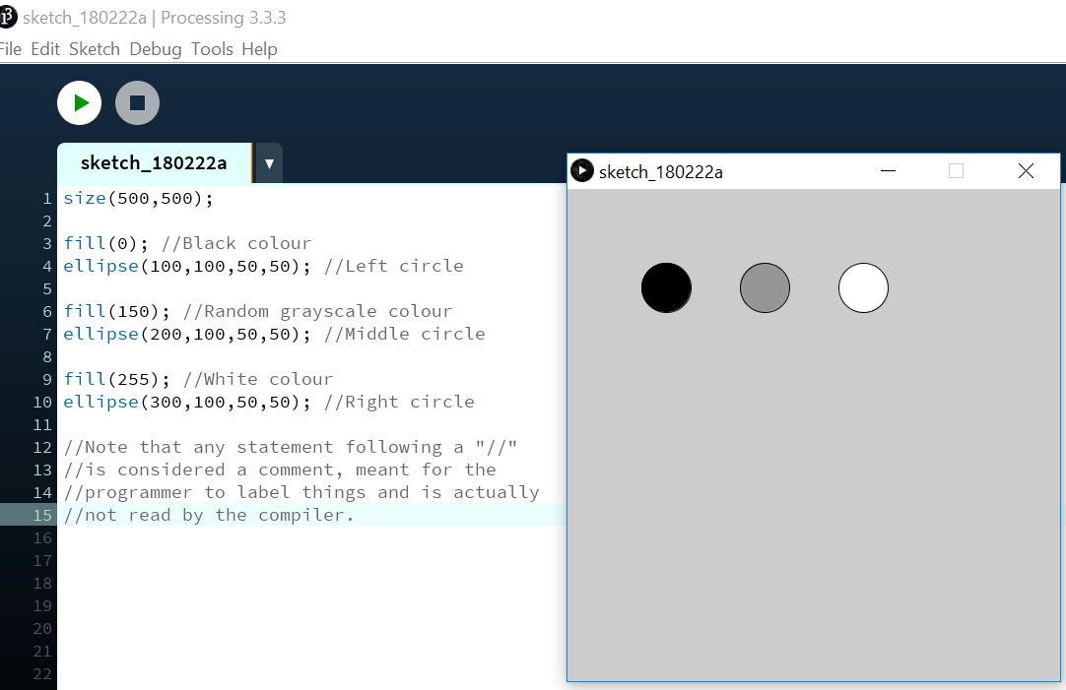
Predefined Functions – fill()

Slide 21
Predefined Functions – print() and println()
The print() function prints text or function outputs to the console (which is the black box underneath your code)
To print a message, you must have double quotations, i.e. print(“Coding is fun.”)
The print() function prints in the same line every time it is called
The println() function is similar to the print() function but it prints in a new line every time it gets called (similar to pressing the “Enter” key on a keyboard before adding more text)
Syntax: print(what) or println(what)

Slide 22
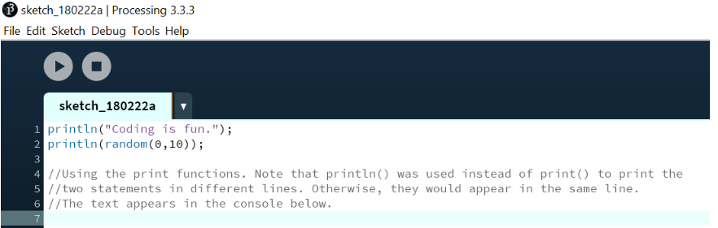
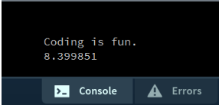
Predefined Functions – print() and println()
Don’t forget that the Processing reference page linked on Slide 5 contains all the information you need for each predefined function!

Slide 23
Summary
Well would you look at that, you’re coding! We’re only going up from here! Now let’s review what we’ve learned.
In this crash course, we learned what coding is all about and were introduced to Processing
Computer programming consists of writing commands in source code that get compiled into machine code (0s and 1s) for execution
Coding can be found in many industries and is consequently a very desirable skill to have
Processing is an open source, Java-based language with an integrated development environment (IDE) for you to write your code in, which helps people learn to code in a visual way

Slide 24
Summary
Processing offers several predefined or library functions such as setup(), draw(), rect(), line(), ellipse(), random(), fill(), print(), and println() that are ready to complete basic tasks for you
Functions are small chunks of code that can be used repetitively
Documentation for predefined functions covered and many more can be found on the Processing website at https://processing.org/reference/
You have completed: 1. Introduction to Processing
Up next: 2. Variables and Data Types

